Slide 1




Ants in Your Pants
Data labelling tool to detect and track ant behaviours

Slide 2
Problem Statement
Automation of behavioural analyses on ants
Achieved by implementing modern machine learning and computer vision tools
However, large labelled training datasets are important to create an accurate model
Currently, there is no user friendly method to collect and label data
Notes:
Eusocial insects have become model systems for studying emergence and swarm intelligence. Investigating the behaviour of social insects is often difficult, due to their sheer numbers and the complexity of the displayed behaviours. Modern machine learning and computer vision tools promise to overcome this limitation, by allowing for automated behavioural analyses, but they crucially rely on large labelled training data sets, which are currently unavailable.
In our group, we have recently developed methods to identify and track individual ants in crowded foraging environments, and to estimate their weight; we are currently implementing simple task recognition. In order to provide the training data to power such methods, we are collaborating closely with a Zoological Garden in a Citizen Science-project: we have access to a large exhibition area, and we plan to supplement the exhibition with interactive touch screens which allow zoo visitors to help with both the generation of training data, and the validation of automated analyses. The task for the group will be to make first step in developing the software front-end for the interactive part of the exhibition, in particular the selection of individual ant workers performing certain tasks via touch screens, and the interaction with the large databases that run in the background, fed with the results from machine learning algorithms.
Specifically leaf-cutter ants

Slide 3
Solution:
To develop a software that enables members of the general community to label datasets that will be used for training the machine learning models

Slide 4




User Requirements
User-friendly UI
Upload
Cloud Database
Export as CSV
Notes:
I feel like we should say input-output. We get video files, label, store in csv file. Also makes some transition into the use case diagram where we go ‘view videos’, ‘select video’ etc.
Server should be able to handle GET and POST requests from the client, and also query the relevant information from the database.
Specific user requirements:
User-friendly interface for video labelling
Administrator should be able to upload unlabelled videos easily to the server
Labelled videos should be stored in a database
Administrator should be able to extract the labelled datasets in a CSV file format from the database

Slide 5
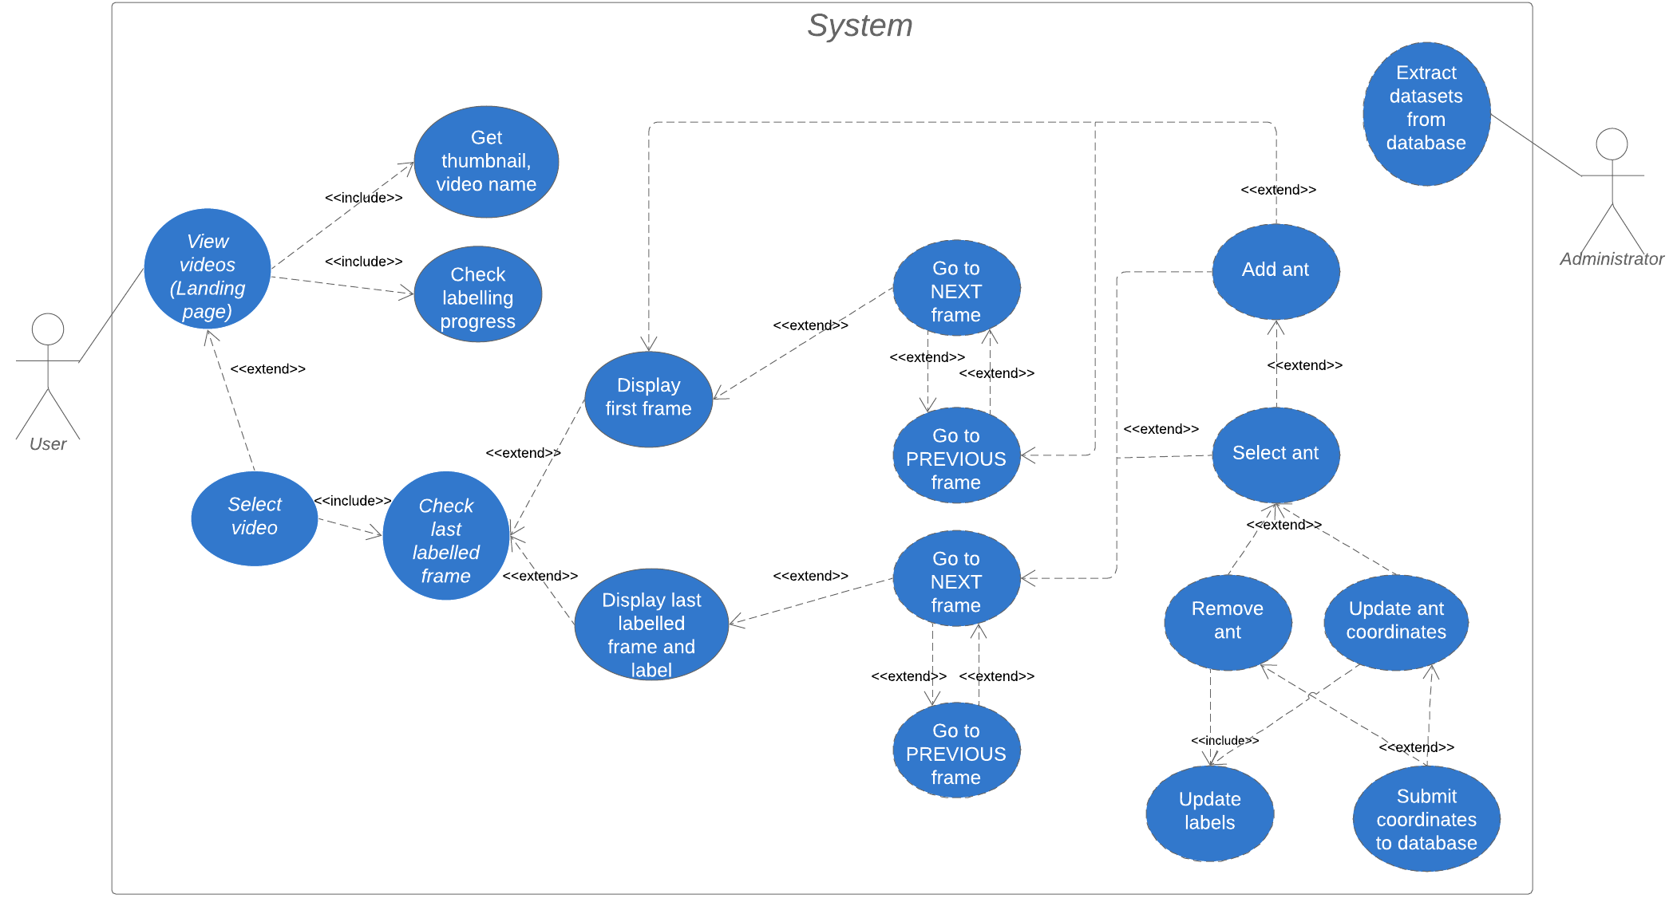

Slide 6
User Requirements: Use Case Diagram

Slide 7





System and Software Design
Java Application
Server
User Interface
Client
Servlet
Database
Resources
Notes:
Big picture
Diagram to show how the whole system is connected
Client-server

Slide 8
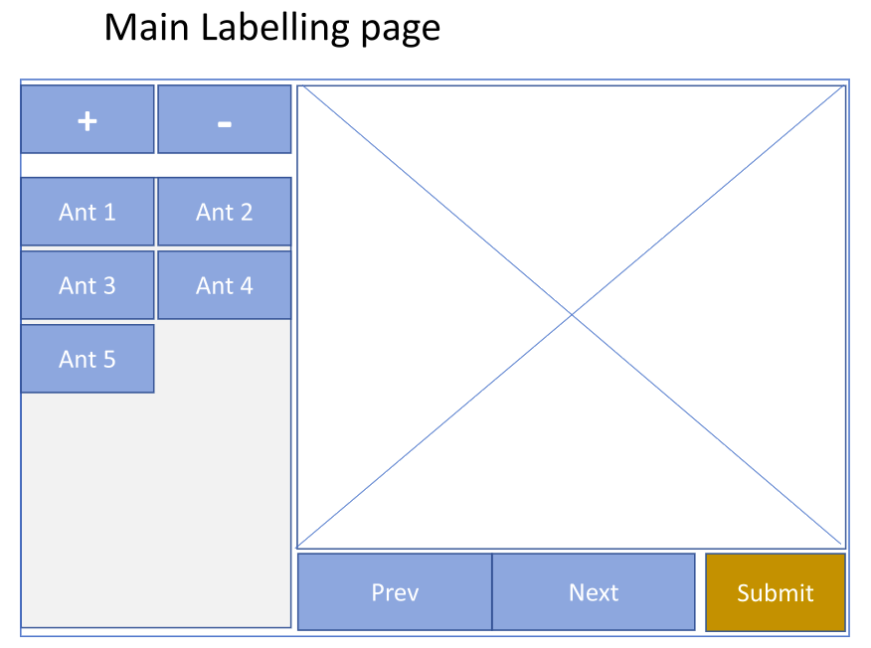

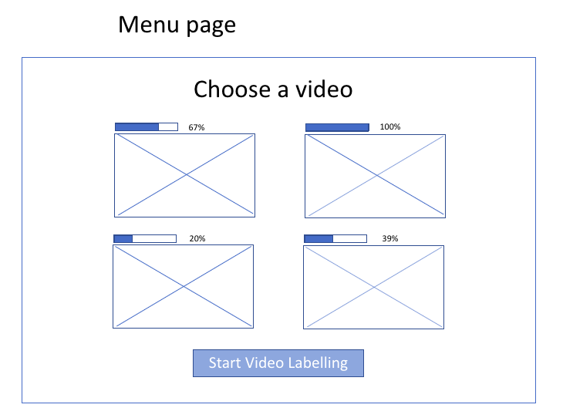
Java Application: Wireframe
3
Tracking Page
1
Landing Page
2

Slide 9
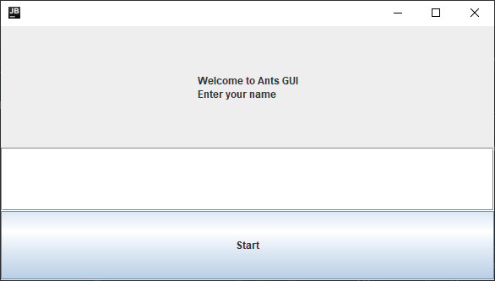
Java Application: UI Design
Username is currently logged locally at each program execution but not on the database.
Notes:
The username is not important for data collection at this stage

Slide 10
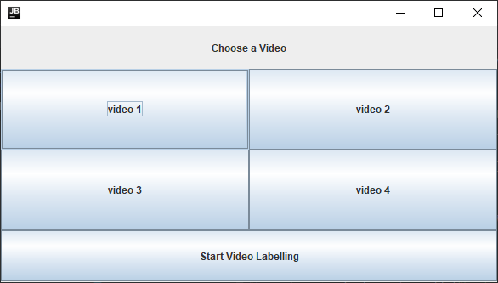
Java Application: UI Design
Video ID will be logged
Currently adding thumbnails (passed on from servlet) to the buttons.
Notes:
Choose a video and chosen ID will be recorded

Slide 11
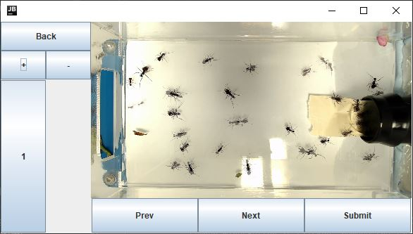
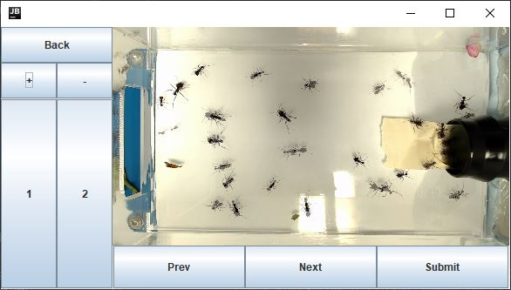
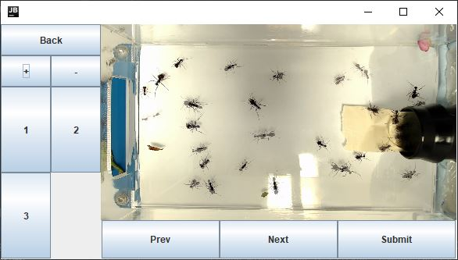
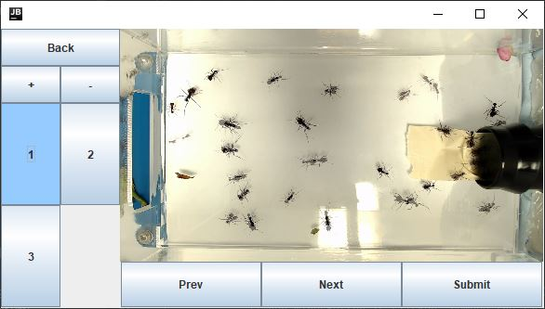
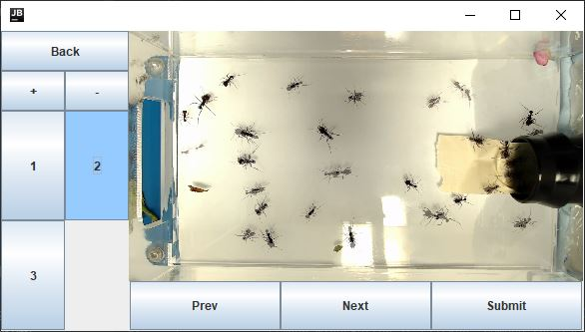


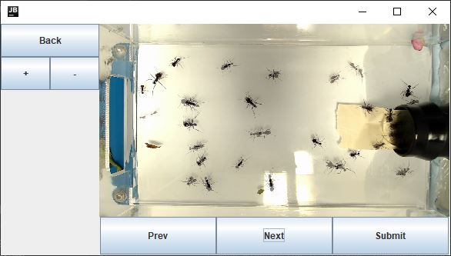
Java Application: UI Design
Ant ID for this frame (frame ID) are logged
Coordinates are logged for this ant
Previous frame will overlay on the current frame with lower opacity
Ant ID are not reusable
If user clicks multiple times for coordinate, only the last entry is saved.
Notes:
User clicks on + sign to add ants.
Click on one antID then use mouse to click on the displayed frame to mark the coordinate for one ant. If user clicks multiple times for one ant, only the last click coordinates are saved.
When labelling, the previous neighbouring frame will be overlayed with current frame, but at lower opacity.
If an ant leaves the frame, click on the ID of that ant then - sign to remove this ID. Note we are not reusing IDs, meaning if ant 2 leaves the frame, the ID #2 will not be used again.
Click submit to update all ants’ coordinates for this frame to the servlet.

Slide 12

Client-Server Connection:
Java Application
initData
initData
Server
videoID
videoID
progress
progress
imageByte
imageByte
User Interface
Client
Servlet
Database
URL Patterns
/init
/landingpage
/fbpage
/submitpage
Resources
Notes:
/init
Client requests InitData from Servlet
Send from Servlet
ArrayList of 4 InitData objects
Each InitData object contains:
String videoID
ArrayList<Integer> progress
Byte[ ] imageByte

Slide 13
Client-Server Connection:
Java Application
Server
videoID
landingData
videoID
User Interface
Client
antData
frameID
Servlet
Database
antID
antData
x_coord
antID
y_coord
URL Pattern
/init
/landingpage
/fbpage
/submitpage
x_coord
y_coord
Resources
Notes:
/landingpage
Client send videoID as a string to servlet
Servlet query last labelled frameID and all the ants coordinates from DB store it in LandingData
Servlet fetch the frame corresponding to that frameID and store it as a byte array in obj LandingData
Each LandingData object has:
ArrayList<ArrayList<Integer>> antData
String videoID
Int frameID
Byte [ ] imageByte
Send over to client as a json string

Slide 14
Client-Server Connection
Java Application
FBData
FBData
Server
videoID
videoID
frameID
frameID
fb
fb
image
image
User Interface
Client
Servlet
Database
URL Pattern
/init
/landingpage
/fbpage
/submitpage
Resources
Notes:
/fbpage
Client send a FBData object containing:
String videoID
Int frameID
Boolean fb
Boolean fb indicates whether the client wants the next frame or previous frame
If fb is true, fetch the next image from resources, convert it into byte and store it in the object
If fb is false, fetch the previous image from resources and all the ants coordinates and store it in the object
Send over FBData object over to client as a jsonstring

Slide 15
Client-Server Connection
submitData
videoID
Java Application
frameID
Server
antData
antID
x_coord
submitData
y_coord
User Interface
Client
Servlet
Database
videoID
frameID
URL Pattern
/init
/landingpage
/fbpage
/submitpage
antData
antID
x_coord
y_coord
Resources
Notes:
/submitpage
Client send SubmitData contains:
ArrayList<ArrayList<Integer>> antData
String videoID
Int frameID
Server extracts the information and store them into the DB

Slide 16
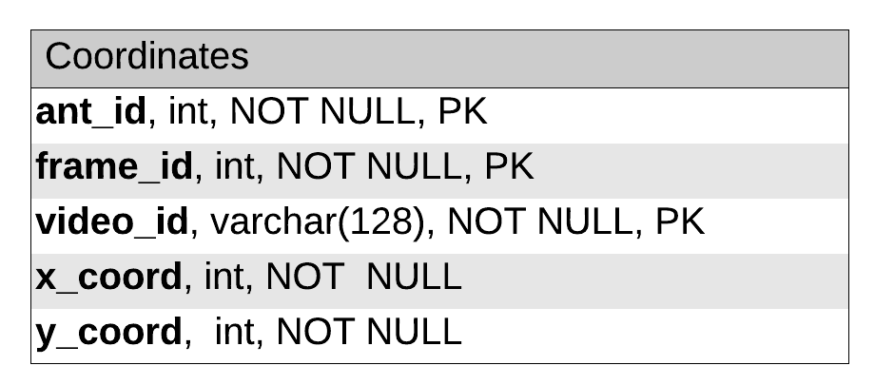
Database: Entity Relationship Diagram
Combination of these attributes form the composite primary key

Slide 17
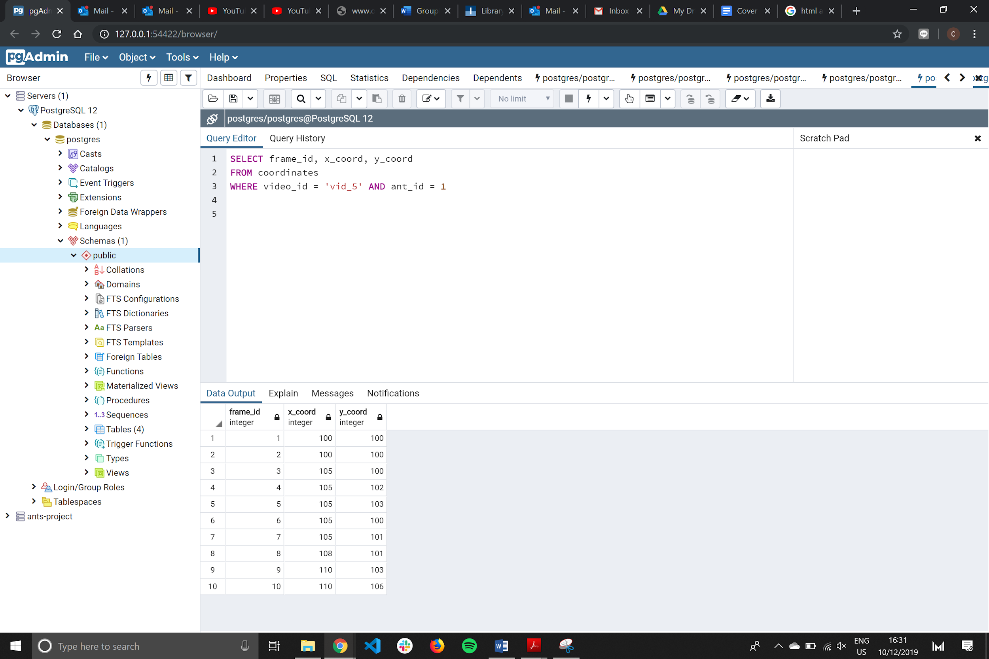
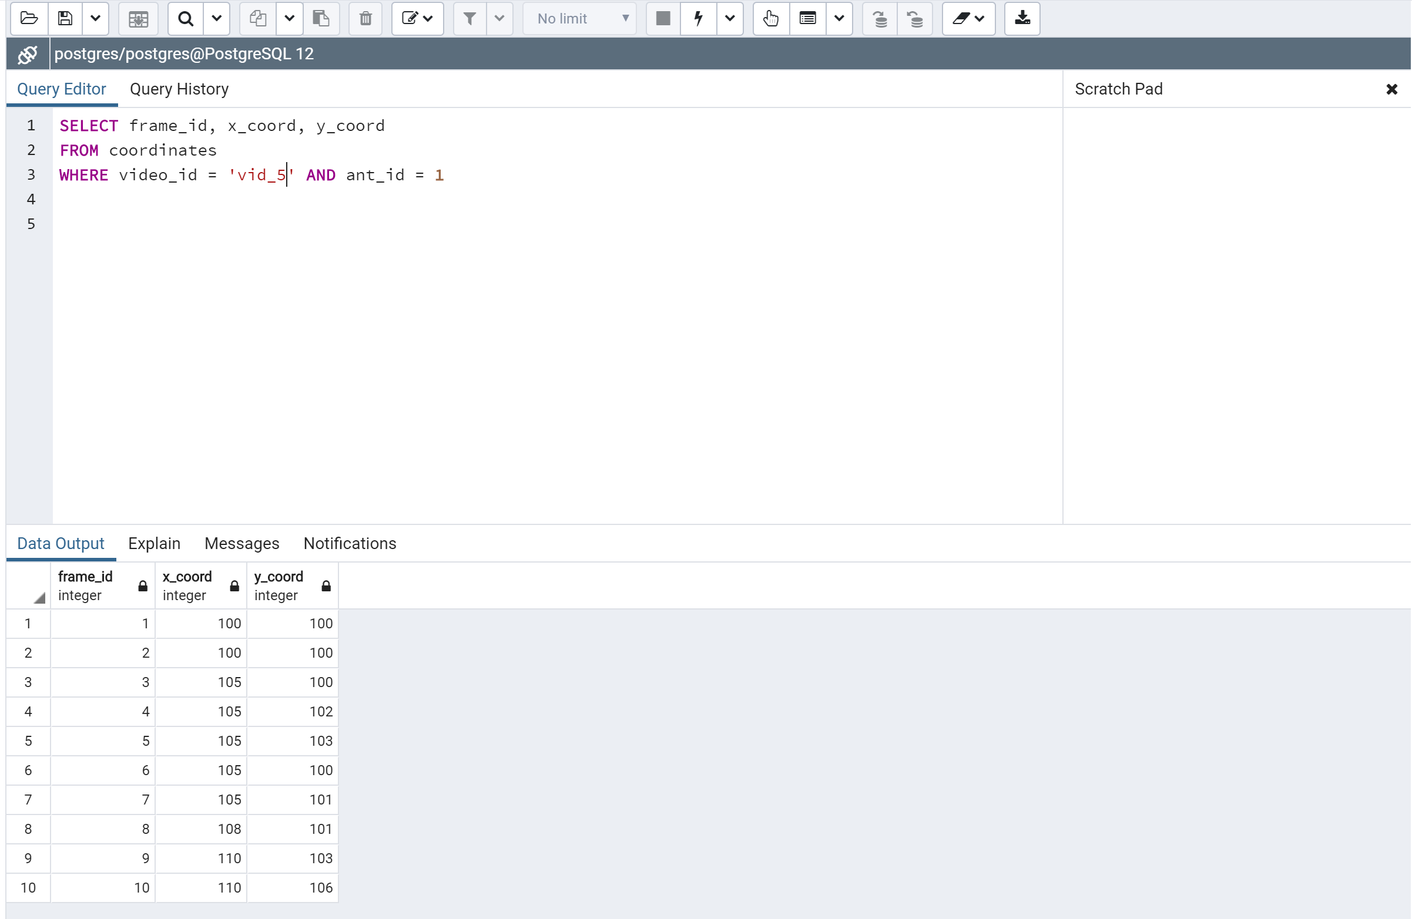

Database: Management Tool
3
1
Queried data can be exported to local directory in CSV file format
pgAdmin allows administrator to interact with the database using SQL queries
2
Data output from the SQL queries can be visualised directly

Slide 18
Database: Management Tool
3
1
2

Slide 19

Database: Management Tool
1
2
pgAdmin allows administrator to interact with the database using SQL queries
3
Queried data can be exported to local directory in CSV file format
Data output from the SQL queries can be visualised directly

Slide 20




Feedback from Fabian
Add visual feedback for each click
Add progress bar
Warn unexpected user input
Verdict:

Slide 21


Next iteration
Deploy the local server to Heroku
Implement new features suggested by Fabian

Slide 22







Tools Used:
Notes:
Java

Slide 23


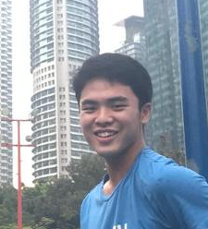

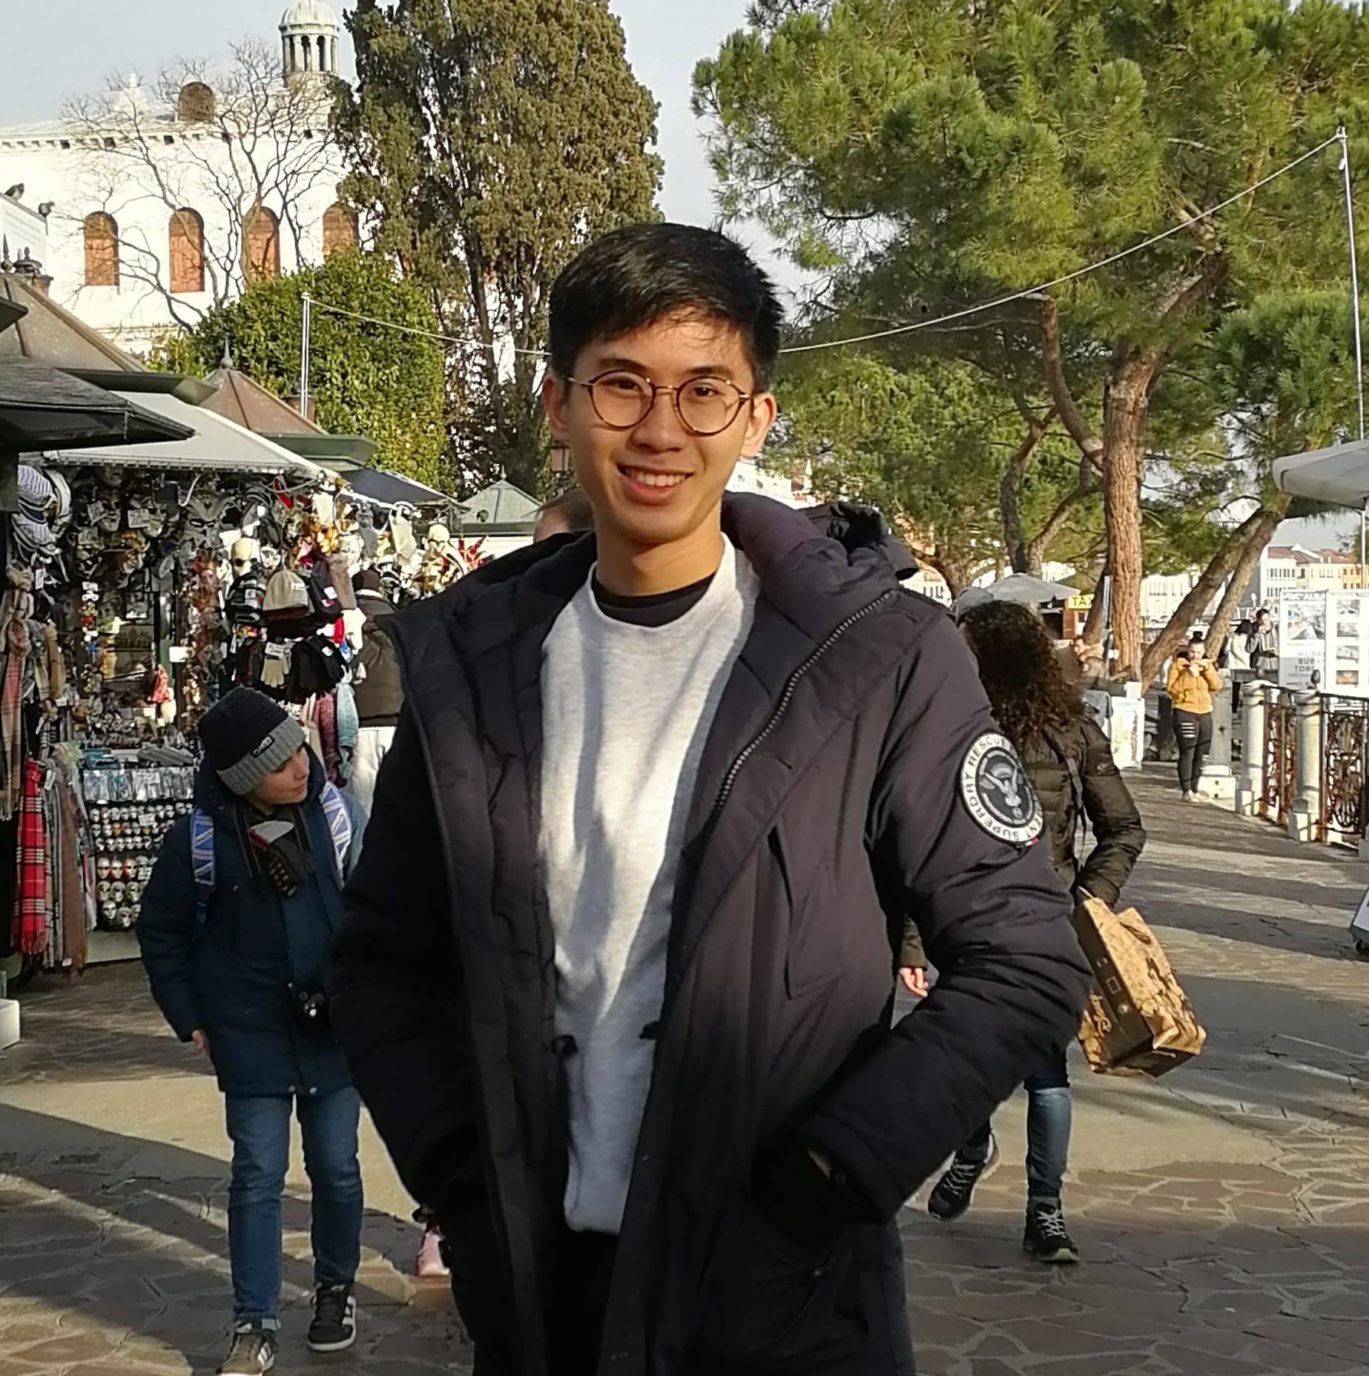
Our Team
Front-end
Back-end
Yi Teng Voon
Xian Zhang
Joshua Sia
Winn Chanasak Mahankarat
Cal-Vin Ng
Ants GUI enhancement
Ants GUI design
Ants GUI Functionalities
Ants Servlet
Ants Database

Slide 24
Thank You!

